Slide 1
Parallel Computations

Slide 2
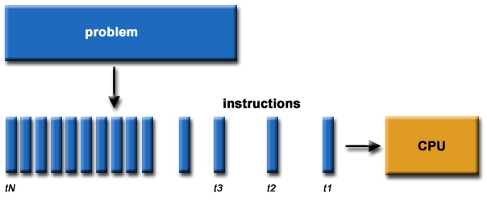
Serial Computations
Single computing node
From beginning to end in series

Slide 3
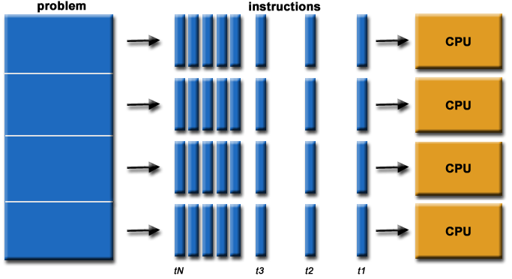
Parallel Computations
Definition: Use of two or more processors in combination to solve a single problem

Slide 4
Parallel Computations
Simple parallel computation
N computing nodes
N separate jobs
Not depending on each other
Taking the same amount of time for all jobs
Distributed easily to the computing nodes
The work would be done N times faster than N serial computations in principle
Called “embarrassingly parallel”

Slide 5
Parallel Computations
Less simple parallel computation
N separate jobs
Still no interaction
Taking widely different amounts of time
Distribute one job to every processor
Putting longer jobs first and shorter ones later
New job will be put to processors done their jobs
“Single queue multiple server” system
Cannot be N times faster

Slide 6
Parallel Computations
Single-job parallelization
A single job taking a very long time
Reorganizing the job to break it into pieces that can be done concurrently
There could be periods when most jobs are just waiting around for some other tasks to be done
Example: Building a house
Plumbing, electrical, foundation, flooring, ceiling, roofing, walls, etc.
Many jobs can be done at the same time
Some have specific orderings (e.g., the foundation first before the walls go up)
Not scaled by N
Most challenging case for parallelization

Slide 7
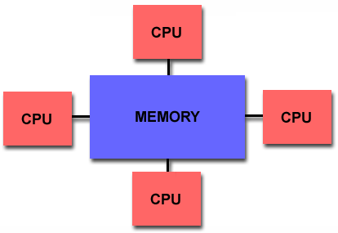
Memory Architectures
Shared memory
Multiple processors can operate independently but share the same memory resources
Changes in a memory location effected by one processor are visible to all other processors.

Slide 8
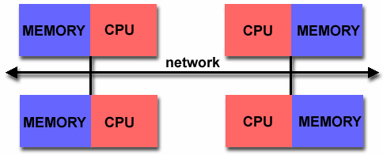
Memory Architectures
Distributed memory
Requires a communication network to connect inter-processor memory
Processors have their own local memory
Memory addresses in one processor do not map to another processor → no global address space

Slide 9
Parallel Programming
Identification of parallelizable problems
Example of parallelizable problem
Each of the molecular conformations is independently determinable
The calculation of the minimum energy conformation is also a parallelizable problem.
Calculate the potential energy for each of several thousand independent conformations of a molecule. When done, find the minimum energy conformation

Slide 10
Parallel Programming
Example of non-parallelizable problem
This is a non-parallelizable problem because the calculation of the Fibonacci sequence as shown would entail dependent calculations rather than independent ones.
The calculation of the k + 2 value uses those of both k + 1 and k. These three terms cannot be calculated independently and therefore, not in parallel.
Calculation of the Fibonacci series (1, 1, 2, 3 , 5, 8, 13, 21, ...) by use of the formula:
F(k + 2) = F(k + 1) + F(k)

Slide 11
Parallel Programming
Identification of the program’s hotspots
Know where most of the real work is being done. The majority of scientific and technical programs usually accomplish most of their work in a few places.
Profilers and performance analysis tools can help here
Focus on parallelizing the hotspots and ignore those sections of the program that account for little CPU usage.

Slide 12
Parallel Programming
Identification of bottlenecks in the program
Are there areas that are disproportionately slow, or cause parallelizable work to halt or be deferred? For example, I/O is usually something that slows a program down.
May be possible to restructure the program or use a different algorithm to reduce or eliminate unnecessary slow areas

Slide 13
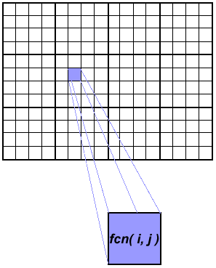
Array Processing – Serial Example
Calculations on 2-D array elements, with the computation on each array element being independent from other array elements
The calculation of elements is independent of one another - leads to an embarrassingly parallel situation.
The problem should be computationally intensive.
Serial code
do j = 1,n
do i = 1,n
a(i,j) = fcn(i,j)
end do
end do

Slide 14
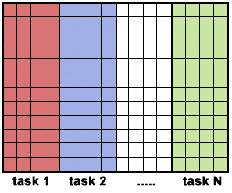
Array Processing – Parallel Solution
Arrays elements are distributed so that each processor owns a portion of an array (subarray).
Independent calculation of array elements insures there is no need for communication between tasks.
Distribution scheme is chosen by other criteria, e.g. unit stride (stride of 1) through the subarrays. Unit stride maximizes cache/memory usage.
Since it is desirable to have unit stride through the subarrays, the choice of a distribution scheme depends on the programming language.
After the array is distributed, each task executes the portion of the loop corresponding to the data it owns. For example, with Fortran block distribution:
Notice that only the outer loop variables are different from the serial solution.
Paralle code
do j = mystart, myend
do i = 1,n
a(i,j) = fcn(i,j)
end do
end do

Slide 15
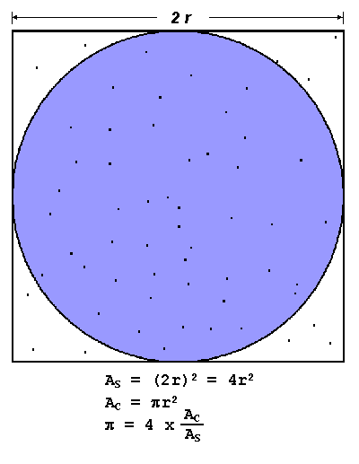
Parallel Example – π Calculation
Inscribe a circle in a square
Randomly generate points in the square
Determine the number of points in the square that are also in the circle
Let r be the number of points in the circle divided by the number of points in the square
π ~ 4r
Note that the more points generated, the better the approximation

Slide 16
Parallel Example – π Calculation
Serial code
npoints = 10000
circle_count = 0
do j = 1,npoints
generate 2 random numbers between 0 and 1
xcoordinate = random1 ; ycoordinate = random2
if (xcoordinate, ycoordinate) inside circle
then circle_count = circle_count + 1
end do
PI = 4.0*circle_count/npoints

Slide 17
Parallel Example – π Calculation
Paralle code
npoints = 10000
circle_count = 0
p = number of tasks
num = npoints/p
find out if I am MASTER or WORKER
do j = 1,num
generate 2 random numbers between 0 and 1
xcoordinate = random1 ; ycoordinate = random2
if (xcoordinate, ycoordinate) inside circle
then circle_count = circle_count + 1
end do
if I am MASTER
receive from WORKERS their circle_counts
compute PI (use MASTER and WORKER calculations)
else if I am WORKER
send to MASTER circle_count
endif

